Slide 1
Computer Organization
Special Topics

Slide 2
Topic One

Slide 3
CISC & RISC
An important aspect of computer architecture is the design of the instruction set for the processor
Early computers had small and simple instruction sets to minimize the hardware used to implement them.
As digital hardware became cheaper with the advent of integrated circuits, computer instructions tended to increase both in number and complexity

Slide 4
CISC & RISC
Many computers have instructions that include 100 to 200 instructions.
These computers support a variety of data types and a large number of addressing modes.
Why?
Computer designers wanted to be able to support many applications
The need to add instructions to facilitate the translation from high level languages into machine language
A computer that has a large number of instructions is classified as a Complex Instruction Set Computer (CISC)

Slide 5
CISC & RISC
In the early 1980’s a number of computer designers recommended that computers use fewer instructions with:
Simple constructs
They can be executed faster within the CPU without having to use memory as often
These computers are classified as Reduced Instruction Set Computers or RISC.

Slide 6
CISC Characteristics
A large number of instructions – typically from 100 to 250 instructions
The instruction set includes specialized instructions that are used infrequently
A large variety of addressing modes – typically from 5 to 20 different modes
Variable length instruction formats
Instructions that manipulate operands in memory

Slide 7
CISC Characteristics
A large number of instructions – typically from 100 to 250 instructions
Why?
Requirements imposed from high-level programming languages Since the translation from a high level language to a machine language is done by means of a compiler program ad the desire to simplify the compilation.
The task of the compiler is simplified if here are machine instructions that implement the high level statements directly.

Slide 8
CISC Characteristics
Variable length instruction formats
Instructions that require only register operands are smaller in length (number of bytes) than instructions that work with memory operands
Variable length instructions require special complex circuits to decode them.

Slide 9
CISC Characteristics
Instructions that manipulate operands in memory
Although CISC processors have instructions that use only processor registers, the availability of other modes of operations tend to simplify high-level language compilation.
However, as more instructions and addressing modes are incorporated into an instruction set, the more hardware logic is needed to implement and support them.

Slide 10
RISC Characteristics
Relatively few instructions
Relatively few addressing modes
Memory access is limited to load and store instructions
All operations are done within the registers of the CPU
Fixed-length, easily decoded instruction format
Relatively large number of registers in the processor

Slide 11
RISC Characteristics
Relatively few instructions
The small set of instructions of a typical RISC processor consists mostly of register to register operations
It also includes instructions like load and store for memory access
An operands is brought from memory to a register via a load instruction
Result of an operation is transferred to memory via a store instruction
This simplifies the instruction set and encourages the optimization of register manipulation

Slide 12
RISC Characteristics
Relatively few addressing modes
This is because almost all instructions have simple register addressing.
Other addressing modes may be included such as immediate operands and relative addressing mode.

Slide 13
RISC Characteristics
Fixed length, easily decoded instruction formats
By using a relatively simple instruction format, the instruction length can be fixed and that makes there decoding easier
By simplifying the instructions and their format, the control logic is simplified

Slide 14
RISC Characteristics
Relatively large number of registers in the processor
This is useful for storing intermediate results and for optimizing operand references
Information transfer between registers is much faster than information transfer between register to memory or between memories

Slide 15
Topic 2

Slide 16
Overview of Instruction SET Implementation
Designers will decide on the instructions that they would like to include in the instruction set e.g.
Arithmetic Instructions
Logic Instructions
Data Manipulation
Data Movement
etc.

Slide 17
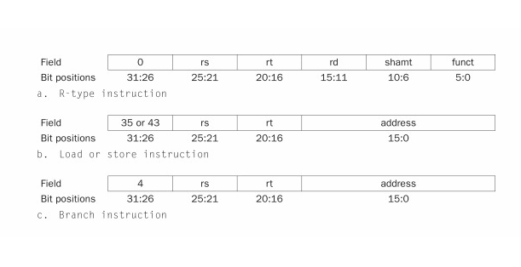
Overview of Instruction SET Implementation
Designers decide the format of the instructions: number of bits nd the allocation of bit fields

Slide 18
Overview of Instruction SET Implementation
A hardware design that supports the implementation of the instruction set is proposed

Slide 19
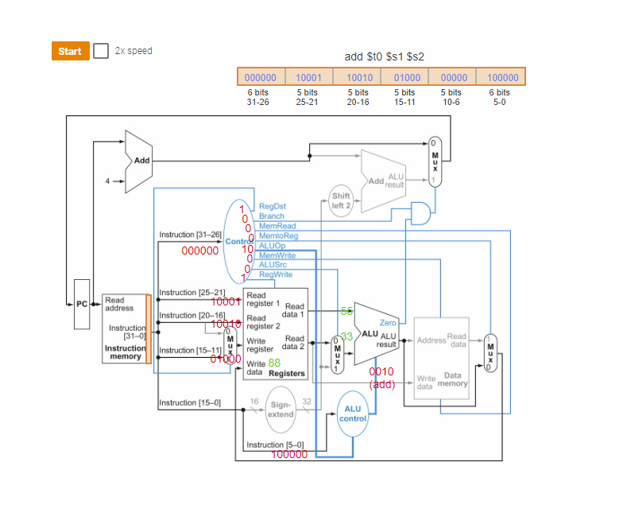

Slide 20
Overview of Instruction SET Implementation
Control Logic is designed:
They can decide that all instructions execute in one clock cycle
Or they can choose multi clock cycle implementation for each instruction

Slide 21
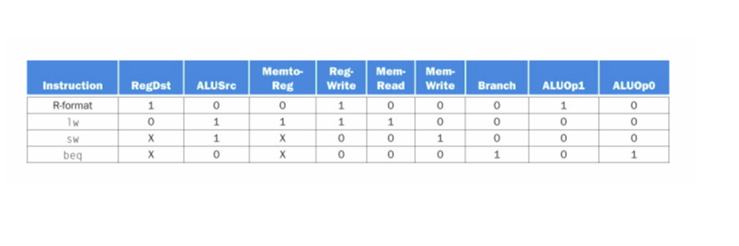
Overview of Instruction SET Implementation
One Clock Cycle for each instruction: construct a truth table and implement with logic gates

Slide 22
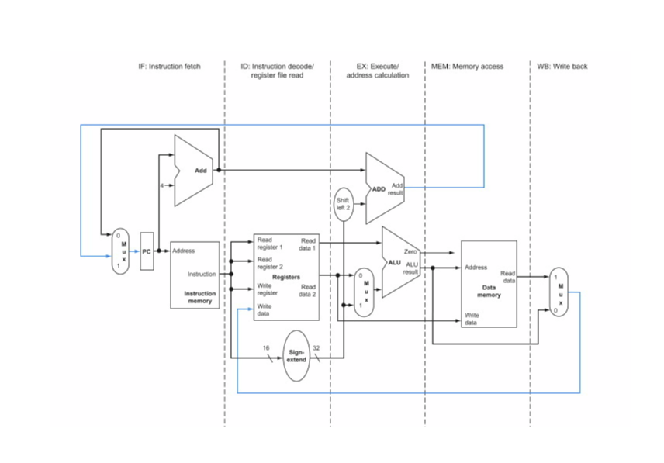
Overview of Instruction SET Implementation
Multi-Clock Cycles for each instruction:

Slide 23
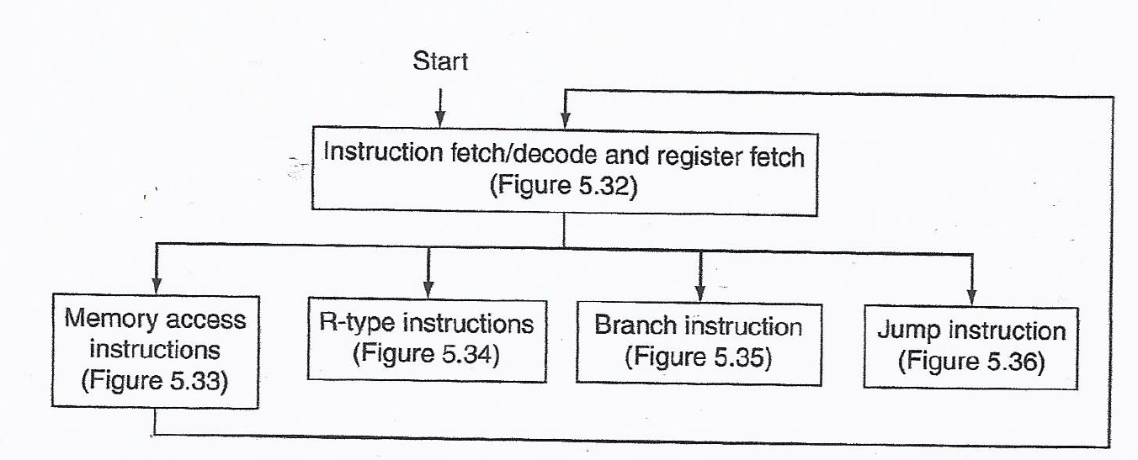
Overview of Instruction SET Implementation
Multi Clock Cycle for each Instruction Implementation: Construct a State Machine

Slide 24
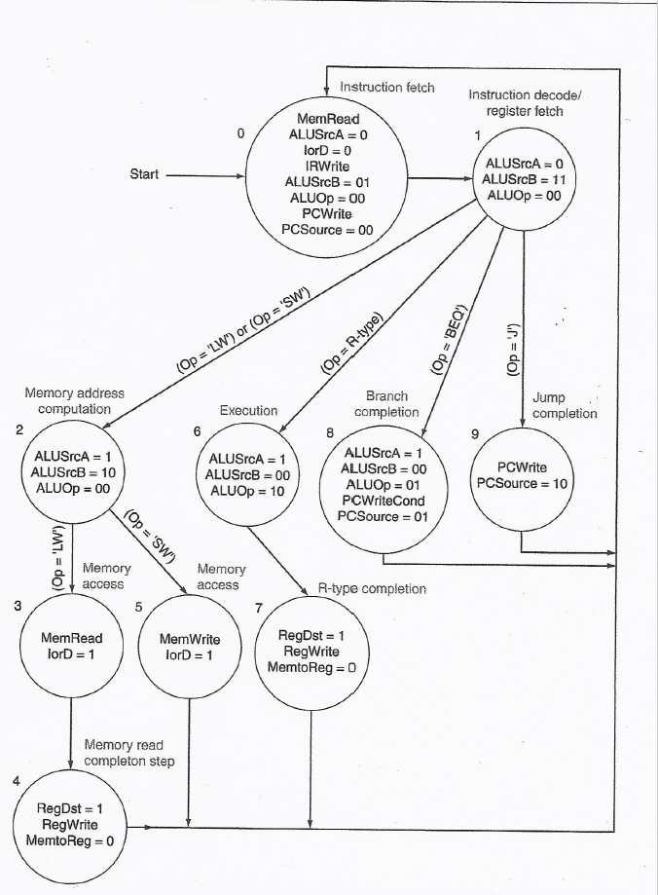

Slide 25
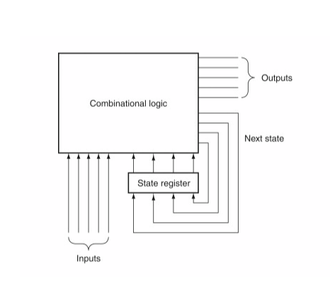
Overview of Instruction SET Implementation
Logic Gates Implementation of the State Machine

Slide 26
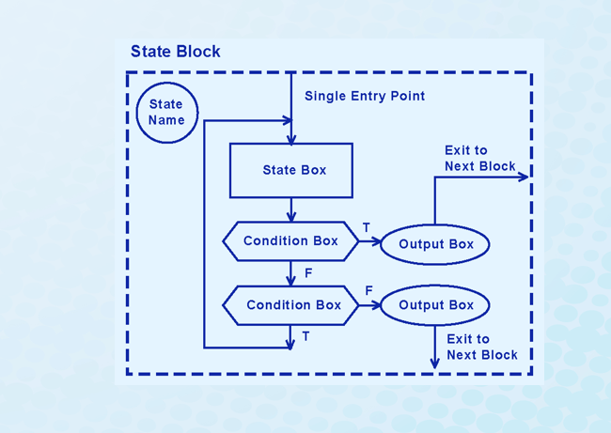
Overview of Instruction SET Implementation
Implementing the State Machine as a Program: Microprogramming

